Slide 1
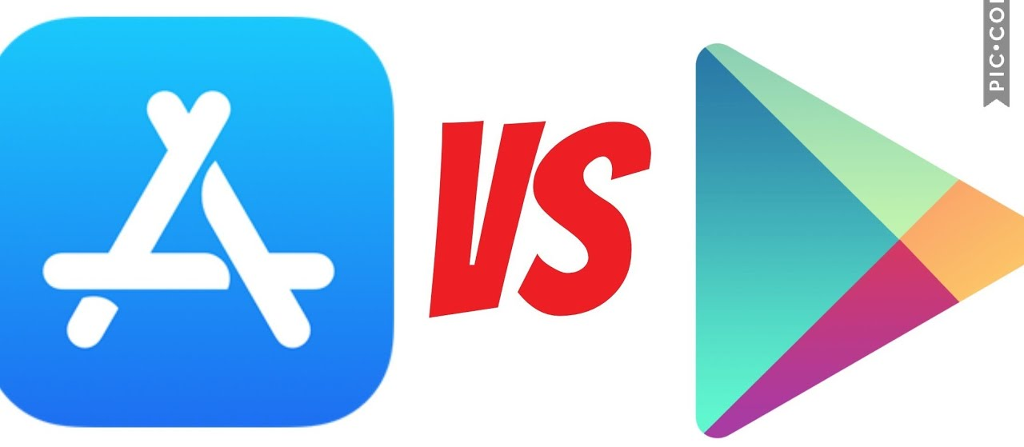
Data science project – apple store vs google store

Slide 2
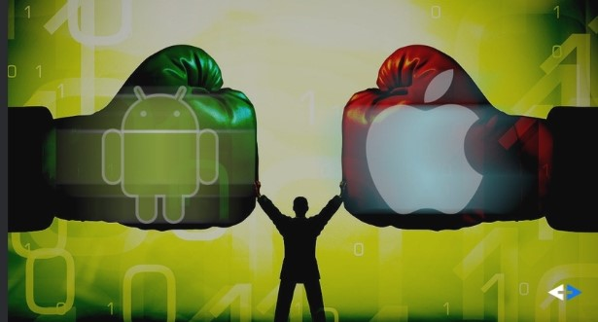
Students:
Netanel Tarnorudsky 315424689
Mor Ofir 308269521

Slide 3
Our databases
Data | Number of apps | Number of rows
applestore | 7198 | 7198
googleplaystore | 10841 | 10841
googleplaystore_user_reviews | 64295 | 64295
7198 | 7198 | appleStore_description

Slide 4

Evaluation

Slide 5

Answering several questions
What are the most popular categories?
What is the affect of price on applications popularity?
What is the average price of app?
is the Distribution of User ratings, increasing if the Price is bigger?
Top 10 favorite applications (App store /Play store)
Which are the apps that have the longest description?
"Can i predict my application ratings?
What is the revenues differences between the stores?
What is Polarity? Subjectivity? (sentiment analysis)
Most common words used in Reviews section?

Slide 6
Apple cleaning and EDA
Insights:
-We can see Games is the most popular Category in app store.
- We can tell by the first graph is that navigation is among the Categories that are less in common apple store,
i suggest that it's because "Apple maps" and "Google maps" providing the best navigation apps and controlling this mobile market.
-Also we can see that apple users happily give good rating, the median rating is 4.0
Paid vs. Free applications:
-We see that games is still the favorite category (free of paid apps)
-Education apps ranked higher in the Paid section, which means apps developers deliberately develop apps in order to get paid, Knowledge (medical) is power.
-As we can see Shoping apps are nearly all free, also Social networks are nearlly all free,
We can explain that theire busniness model its edvertising.

Slide 7
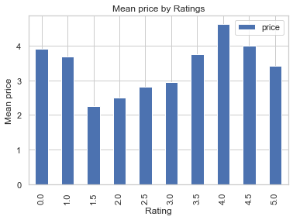
Very few apps have been priced above 25 USD
If you want your app get more download the payment should be less than 25 USD
Average price is: 3.95
Most expensive app is from Education category, rated 4.0 and weights more than half GB
Is this an anomaly or its normal case?
The answer is this is anomaly,
as we can see there is not connection between the two things. We can see that pricey apps is nearly 1 GB, while there are many more apps greater than 1GB, and their price is less than 10 usd.
is the Distribution of User ratings, increasing if the Price is bigger?
The answer is no!
As we can see the Top rating apps is not the most expensive apps

Slide 8
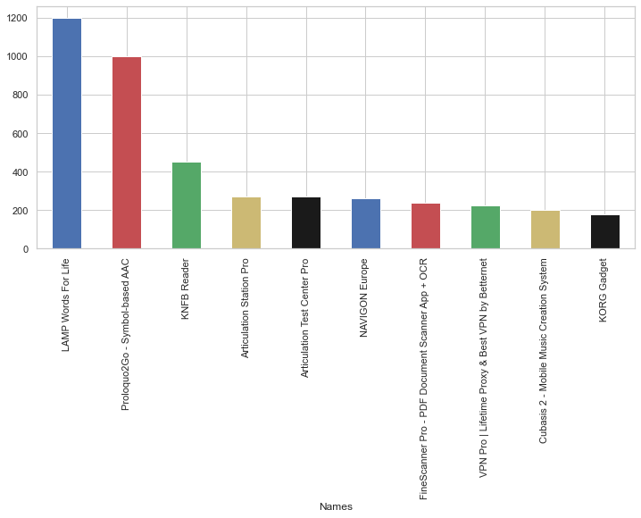
Top 10 pricier applications
The average price in top 10 apps is about 100 USD, which is not a small price, but all of the apps is above 40 USD,
and between 40-80 usd, in order to earn maximum profit the application should be around this area of price.
-The average size of applications is about 400mb, The average Rating of this successful application is 4.2, which is quiet understandable, If you want to profit from application you need that people will love it.
-Most categories here are Education, Music and Productivity - this are the categories that are worth paing for!

Slide 9
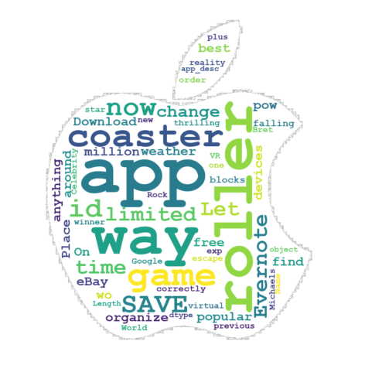
Analyzing Application descriptions
-Every application developer is trying to get new 'Features' into his app, that what make his app so significent.
-Most of Aplications describe section is filled with requirements and support information in order to help user alert on bugs.
-Longest Application descriptions was Productivity, Games and music my insight it's because the Productivity apps need to be explained, How the is app working, What the application purpse and more.
Games also needs to be explained, but also have to have appealing description in order people to play this game instead thousends of games available in AppStore.
-Also we see there is no real strong connection between size of the application number of words in description.

Slide 10
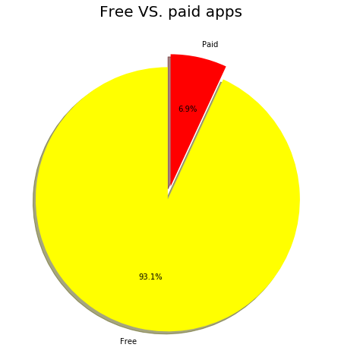
Google play cleaning and EDA
Based on the pair plots we conclude that free applications get higher ratings.
Still, the overall distributions of ratings for free applications and paid applications respectively are highly similar.
The same can be said for the overall distributions of sizes for free applications and paid applications.
Meanwhile, although free applications have more installations then paid applications, paid applications received more reviews than free applications
The information we got from the previous plot(price has a negetive affect on popularity) can explain why there are so few paid apps.

Slide 11


Slide 12
App store
Our main question is "Can I predict my application ratings?"
The k-nearest neighbors' algorithm is based around the idea of predicting unknown values by matching them with the most similar known values. To make a prediction for a new data point, the algorithm finds the closest data points in the training dataset — its "nearest neighbors". (As we learn in class)
- The R^2 score that specifies the goodness of fit of the underlying regression model to the test data.
- We can see that the score is high, that mean this model can predict rating(y) in a very good way.
now on this Machine learning chapter, we can try and guess the Rating of the application before it even will be published, by setting values before (like price ,category, number of supported device and size in Mbytes) that's amazing!

Slide 13
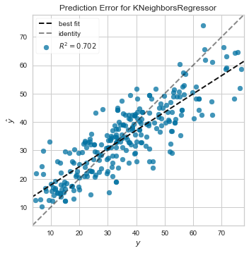
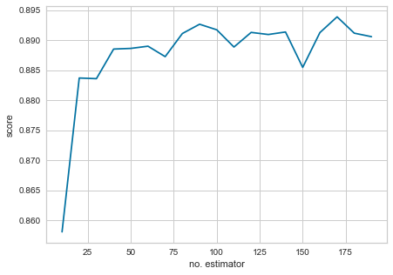
Apple store
We can see there (using RandomForestRegressor) is improvement (89% +).

Slide 14
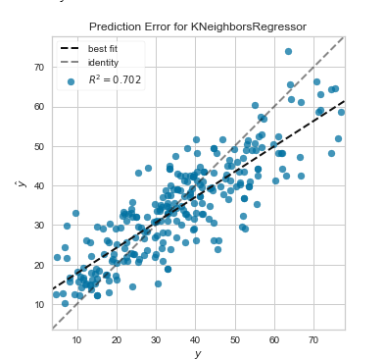
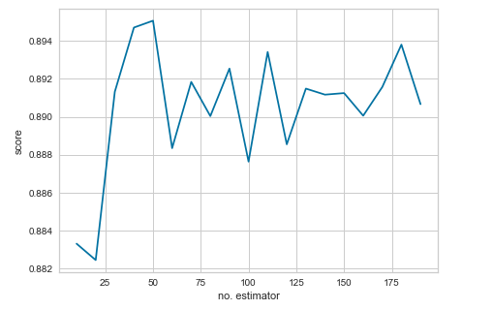
Google play store
We can see there (using RandomForestRegressor) is improvement (89% +).

Slide 15
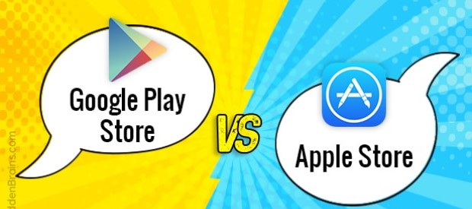

Slide 16
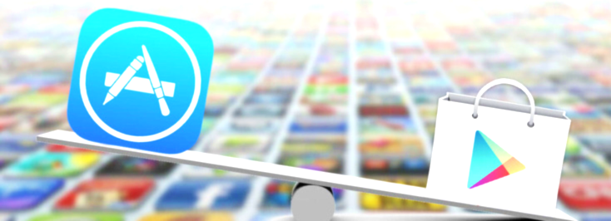
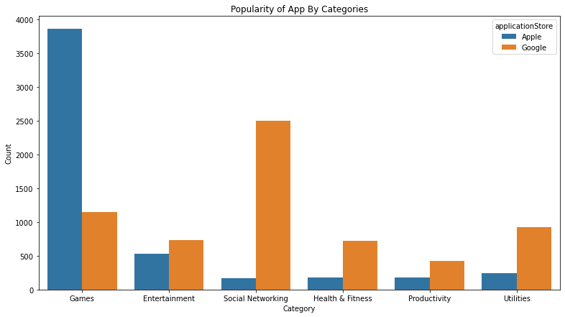
Insights:
As we can see the distribution of applications categories are different, it seems that apple store (and users) are focusing on games instead social media as play store users. (Games category is worth more than half of the applications in the store)
-In google play store there are more diversion, but social media is ruling with no doubt.

Slide 17
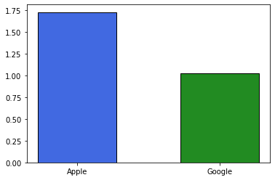
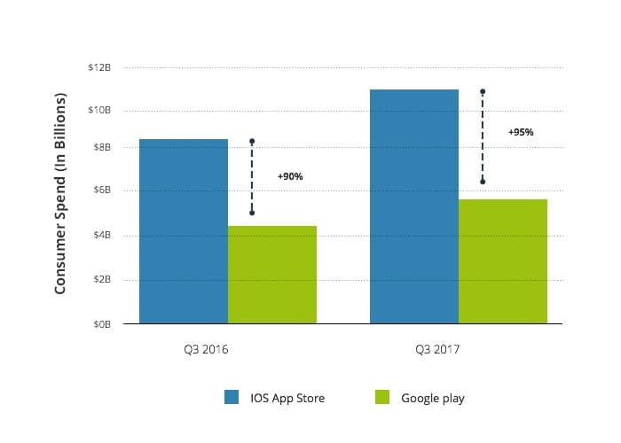
revenues differences
The scraped image from ddi-dev blog and the graph before (revenue diffrences in the left) are quite similar, Even though it's a rough analysis, We can know the dataset is reliable (this dataset if from 2018).

Slide 18
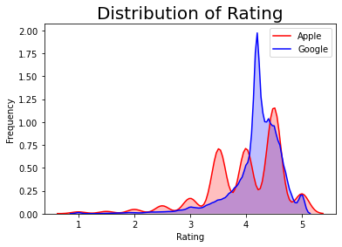
Most Popular App by Genre on the App Store
A way to find most popular app is to calculate the average number of installs for each app genre. In Google Play data set, we can find this information in the Installs column, but for the App Store data set this information is missing.
Another way I'm going to take the total number of user ratings , which we can find in the RatingNum.
Below, we calculate the average number of user ratings per app genre on the App Store:
Mean apple Ratings: 3.982097262748367
Mean google Ratings: 4.191654428044281
There were 1474 NaN's (Missing data) in Play Store, and 929 in App Store, which is 0.135 and 0.129 percent (Respectively), that's not a lot so i inserted the mean Rating of each store.
We also can see that Ratings are similar, Average is very close.

Slide 19
Google Reviews Sentiment
This file contains the first 'most relevant' 100 reviews for each app.
Each review text/comment has been pre-processed and attributed with 3 new features - Sentiment, Sentiment Polarity and Sentiment Subjectivity.
Polarity
It simply means emotions expressed in a sentence. Emotions are closely related to sentiments. The strength of a sentiment or opinion is typically linked to the intensity of certain emotions, like joy and anger. Opinions in sentiment analysis are mostly evaluations(although not always).
According to consumer behavior research, evaluations can be broadly categorized into two types:
Rational evaluations
Emotional evaluations. Rational evaluation: Such evaluations are from rational reasoning, tangible beliefs, and utilitarian attitudes. For example, the following sentences Express rational evaluations: “The voice of this phone is clear,” “This car is worth the price,” and “I am happy with this car.” Emotional evaluation: Such evaluations are from non-tangible and emotional responses to entities which go deep into people’s state of mind.
For example, the following sentences express emotional evaluations: “I love iPhone,” “I am so angry with their service people” and “This is the best car ever built.”
Subjectivity
Subjective sentence expresses some personal feelings, views, or beliefs.
An example: subjective sentence is “I like iPhone.” Subjective expressions come in many forms, e.g., opinions, allegations, desires, beliefs, suspicions, and speculations.
A subjective sentence may not express any sentiment. For example, “I think that he went home” and “I want a camera that can take good photos” are a subjective sentences, but does not express any sentiment.
(Source: Bing Liu. Sentiment Analysis and Opinion Mining, Morgan & Claypool Publishers, May 2012)

Slide 20
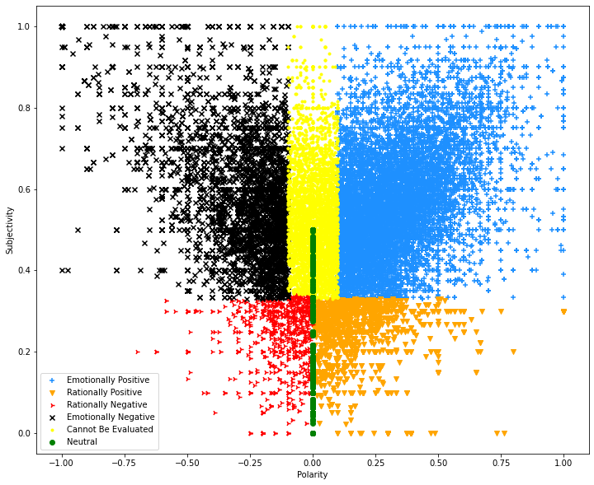
'Emotionally Negative' -> Sentiment_Polarity less than -0.1, Sentiment_Subjectivity more than 0.33.
'Rationally Negative' -> Sentiment_Polarity less than 0 , but the Sentiment_Subjectivity less than 0.33
'Neutral' -> Sentiment_Polarity is 0 and Sentiment_Subjectivity is less than 0.5. (very subjective is not Neutral)
'Rationally Positive' -> Sentiment_Polarity more than 0 (or equal) and the Sentiment_Subjectivity less than 0.33 (third)
'Emotionally Positive' -> More than 0.1 (Polarity), and Sentiment_Subjectivity more than 0.33.
'Cannot Be Evaluated' -> All the rest
We can see the division pretty good, A graph of plotted points that show the relationship between two sets of data.
We can also see that the most of reviews are good, which is surprising to me.
Most of the reviews are subjectively, It's normal because most of the reviewers have feeling and encounterd good or bad experience from those apps and that what motivated them to comment about it.
I think that is the main reason that Emotionally positive is the larger group, Human kind have feeling and people want to be heard, that's why the Rationally emotions are a bit lesser than the emotionally groups.
Although Neutral section is larger than all groups, except the Emotionally positive, The polarity has to be 0 in order to be Neutral. (That's why it's a line)

Slide 21
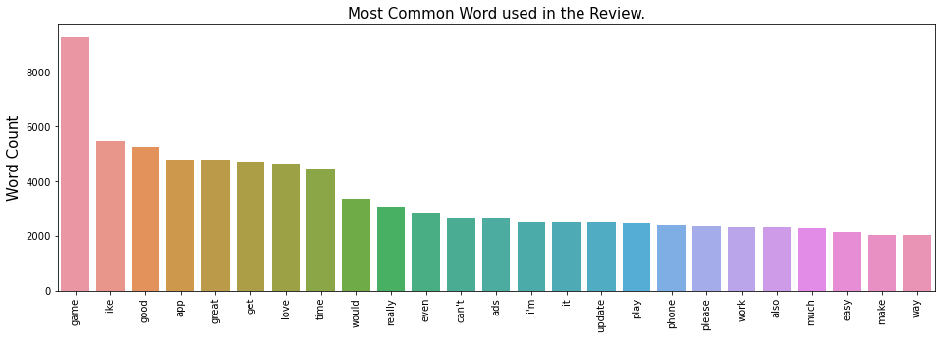
Emotional Negative:
Average polarity: -0.1617
Average Subjectivity: 0.226
Rational Negative:
Average polarity: -0.361
Average Subjectivity: 0.6206
Emotional Positive:
Average polarity: 0.426
Average Subjectivity: 0.617
Rational Positive:
Average polarity: 0.3017
Average Subjectivity: 0.238
Neutral:
Average polarity: 0.0
Average Subjectivity: 0.0394

Slide 22
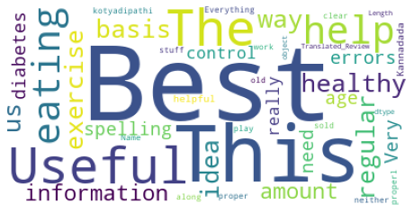
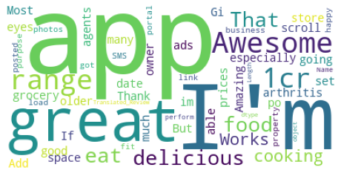
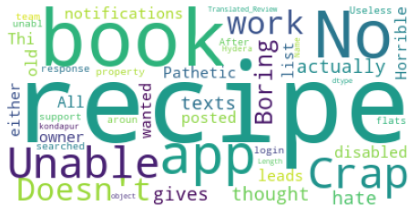
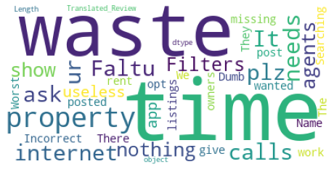
We can see the big difference between the "rational" and the "Emotional" comments/reviews, in both of "Emotional" word cloud we see that a lot of word are depicting, like "waste" of time, "Awesome", "great", "usless" etc... while in the rational is not like that and a lot of the words are nouns like "recipe", "book","basis", etc...
We can spot the difference between the Positive and the Negative reviews pretty easily, negative words(crap, no, dosent...) vs. positive words (great, best,usefull...)
Can you assign wordcloud to sub-Category?

Slide 23
Conclusion
We started our project with our own assumption about which apps were popular and why and we ended up proving some of our assumptions and disproving others

